Slide 1
Business Continuity Plan

Slide 2
Definitions ( 1 / 2 )
Business continuity is the ability of an organization to maintain essential functions during, as well as after, a disaster has occurred.
A Business Impact Analysis (BIA) differentiates critical (urgent) and non-critical (non-urgent) organization functions/activities.

Slide 3
Definitions ( 2 / 2 )
Recovery Point Objective (RPO)
  the acceptable latency of data that will not be recovered.
Recovery Time Objective (RTO)
  the acceptable amount of time to restore the function.

Slide 4
Business Critical Services

Slide 5

for the General Practioner
document on the hubs (intrahub)
status of vaccination (vaults)
consulting a SUMEHR (vaults)
status of insurability (genins)
create a pharmaceutical prescription (recip-e)

Slide 6
for the General Practioner
determine the correct tariff for a patient (eTarif)
determine the correct tariff for a ‘Mediprima’ patient (Mediprima tarif)
send the paying third party invoice (eFact)

Slide 7
for the Pharmacist
status of insurability (insurability)
read a pharmaceutical prescription (recip-e)
consult an authorization for a Chapter IV medicine (chapterIV)
consult the shared pharmaceutical file (GFDDPP)
archive of a pharmaceutical prescription (RAOTD)

Slide 8
Business Continuity
Action Plan

Slide 9
3 axes improvements
Communication
Internal improvements
External improvements

Slide 10
Communication
https://status.ehealth.fgov.be
Centralized intervention calendar
Twitter account for ‘live’ updates
Links to the monitoring dashboards
Documentation of the different BCP plans

Slide 11
Internal improvements
Infrastructure investment continues
completely redundant on 2 separate sites
less then 50 % of capacity is used on each site
….

Slide 12
External improvements
Protocol changes
add / modify best practices for the eHealth Base services
include the BPC principle by design of new services
using the client side as backup solution (if appropriate in the use case)
For example:
Sending over the end-user ETK in the payload
  KGSS
  eAttest
  Intrahub communications

Slide 13
Best Practices ( 1 / 3 )
Local caching
Encryption Token
End-User is in charge of the certificate process
End-User SHOULD store his ETK locally for the lifetime of the ETK
Session Management
persist safely the SAML token locally

Slide 14
Best Practices ( 2 / 3 )
Sliding window principle
Renew the SAML session token after ½ of the life time
For Example:
Session is valid for 12 hours
Try to renew after 6 hours
If unable to renew, retry after 3 hours
If unable to renew, retry after 90 minutes
If unable to renew, retry after 45 minutes
….

Slide 15
Best Practices ( 3 / 3 )
Master – Slave cache
response OK => adding to cache
response NOK => lookup in the cache
=> found?
=> use cached response
For Example:
Usable in ETKdepot

Slide 16
External improvements
Adding a new BCP environment
Why?
Downtime in August 2018: hardware failure
Solution
using a ‘cold’ datacenter
  completely independent
  other hardware stack
  other ISP
  …

Slide 17
BCP switch mechanism

Slide 18
General principles
WS-I compliant web services
HTTP 200/500 = normal behavior
Other return value: the alternative solutions must be tried
  HTTP 404/503/ ….
  Connection reset
  Connection refused
  ….

Slide 19
Normal situation

Slide 20
RTO

Slide 21
BCP solution actif

Slide 22
ehealth alive and kicking

Slide 23
Normal situation

Slide 24
Servicelist v2

Slide 25
Servicelist v2
Features
contains an overview of
  all the services and the alternatives
  ‘authorized’ caching mechanism
is signed by the eHealth platform
2 files available
  servicelistv2.sha2 (polling purpose)
  servicelistv2.xml (real content)

Slide 26
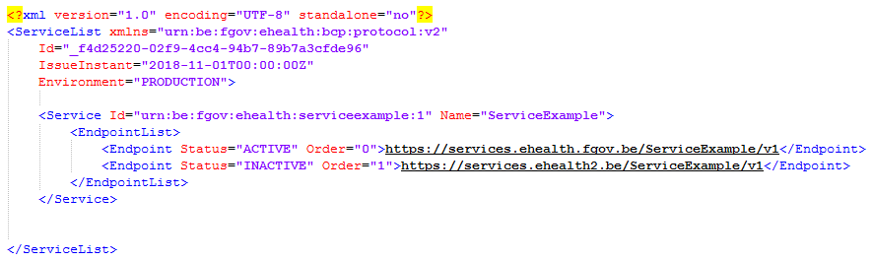
Servicelist v2
Endpoint list

Slide 27
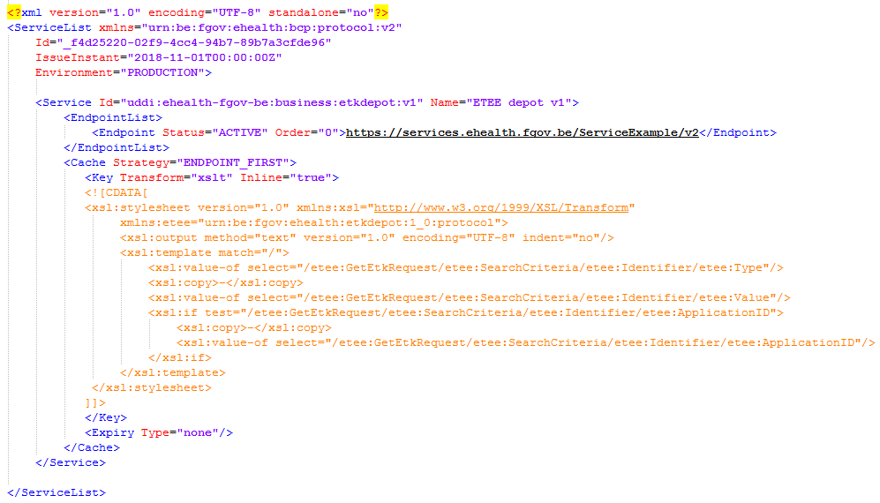
Servicelist v2
Cache configuration

Slide 28
Hands on!

Slide 29
Planning
Connector release
version 3.16.x or higher (octobre 2018)
build-in features:
  Session Management (Sliding Window Technique)
  ServiceList v2
    master/slave caching
    retry mechanism
  Intrahub v3 protocol change

Slide 30
Planning
By the end of decembre
New endpoints will be available
Endpoint simulating a problem with ehealth.fgov.be
https://services-acpt-alt.ehealth.fgov.be
Endpoint on the new BCP environment with active backend
  https://services-acpt.ehealth2.be

Slide 31
Planning
Q1 2019
organization of minilab to verify the solution(s)
  sliding window principle
  local caching
  master – slave mechanism
  switch mechanism
  service list v2
  …
if result is OK
  publication status.ehealth.fgov.be
  Inform the eHealth platform on roll-out in the field

Slide 32
Planning
Next steps
connector will be modified with the new specifications
  3.17.x (april 2019) (intrahub v1 specs)
minilabs will be organized when new solutions are available.
  Intrahub v1 (depending on hubs )
  Intrahub v3 (depending on hubs/vaults)
  …

Slide 33
Interesting links
Cookbooks
End-To-End Encryption – Known Destination
https://www.ehealth.fgov.be/ehealthplatform/file/view/b49edc5ce656876fba0b4005a6ecffdb?filename=ETEE%20Known%20recipient%20-%20Cookbook%20v%202-4%20dd%2018072018.pdf
SecureTokenService – HolderOfKey
https://www.ehealth.fgov.be/ehealthplatform/file/view/6dcee76c3eaafa9ddbefa09ebd0a730e?filename=Secure%20Token%20Service_HolderOfKey%20-%20Cookbook%20v1-3%20dd%2018072018.pdf
ServiceList v2
https://www.ehealth.fgov.be/ehealthplatform/fr/data/file/view/6ec98bb0ba3fdd12cb9a9588178af327f506ffc2?name=eH%20Business%20Continuity%20Plan%20%28BCP%29%20-%20Insurability.pdf

Slide 34
Question? Answers!

